Slide 1
What´s comming in .Net Core 3.0
Hugo Biarge

Slide 2
.Net Core 3.0

Slide 3
Supported Operating Systems
Windows Client: 7, 8.1, 10 (1607+)
Windows Server: 2012 R2 SP1+
macOS: 10.12+
RHEL: 6+
Fedora: 26+
Ubuntu: 16.04+
Debian: 9+
SLES: 12+
openSUSE: 42.3+
Alpine: 3.8+
Chip support
x64 on Windows, macOS, and Linux
x86 on Windows
ARM32 on Windows and Linux
ARM64 on Linux

Slide 4
Winforms and WPF on .Net Core
Can deploy applications in the same machine with different versions of .Net Core
But… Winforms and WPF won´t be multiplaform
In the current preview
We don´t have support for designers (but it´s expected in the final version)
Not all UI frameworks support the new runtime (but it´s expected they do)

Slide 5
C# 8.0 goodness
Ranges and indices
IAsyncEnumerable
using declarations
switch expressions
…
And a lot of improvements in the BCL

Slide 6
Docker and orchestrators improvements
Docker images in Microsoft Container Registry
cpu and memory limits improvements
SDK Docker Images includes PowerShell Core
Better support for orchestrators
docker-compose
Kubernetes
Service Fabric

Slide 7
More interesting things…
.Net Standard 2.1
Tiered compilation
dotnet tools
.Net Core SDK installers upgrade in place
HTTP/2 Support in kestrel and in HTTPClient
Assembly load and unload improvements
.Net Framework Dependent Intrinsics
GPIO Support for Raspberry Pi
IEEE Floating-point improvements

Slide 8
Asp.Net Core 3.0

Slide 9
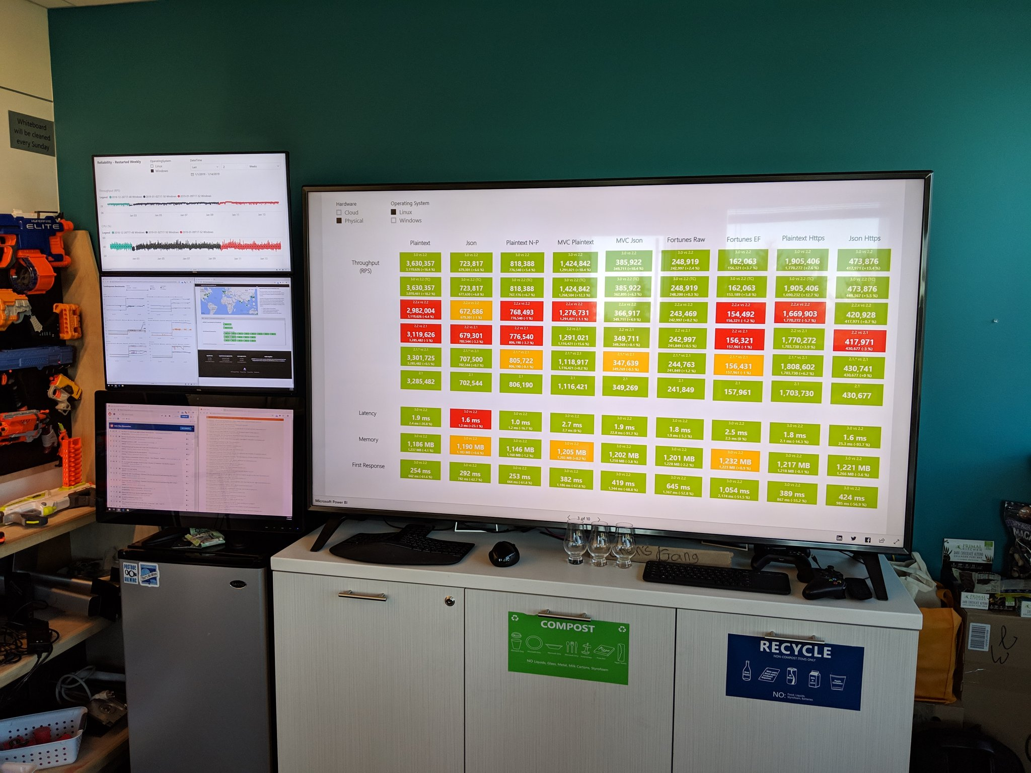




Performance!!!
Plain text
MVC Plain text
Request per second
Memory
https://aka.ms/aspnet/benchmarks
https://github.com/aspnet/Benchmarks

Slide 10
News in templates
Generic Host
Worker SDK
gRPC template
Identity Server in SPA templates

Slide 11
Endpoint routing
Third router implementation for Asp.Net Core
Almost like angular ;)
Allow moving more logic from Mvc to middlewares

Slide 12
Blazor
https://blazor.net
http://ievangelistblazingchuck.azurewebsites.net/

Slide 13

Client-side web apps with .NET Core 3.0 & Blazor
Build client-side web UI with .NET instead of JavaScript
Write reusable web UI components with C# and Razor
Share .NET code with both the client and the server
Call into JavaScript libraries & browser APIs as needed
Handle client UI interactions on the server over SignalR or directly in the browser via WebAssembly (future)
C#

Slide 14

.NET

Slide 15



Blazor on client or server
Client-side
Server-side
https://...
https...
ASP.NET Core
Razor Components
DOM
SignalR
DOM
.NET
WebAssembly
Razor Components
.NET
Future
.NET Core 3.0

Slide 16




Get started with .NET Core & Visual Studio 2019 today!
Visual Studio 2019: https://visualstudio.com
.NET Core: https://dot.net
Blazor: https://blazor.net

